Slide 1

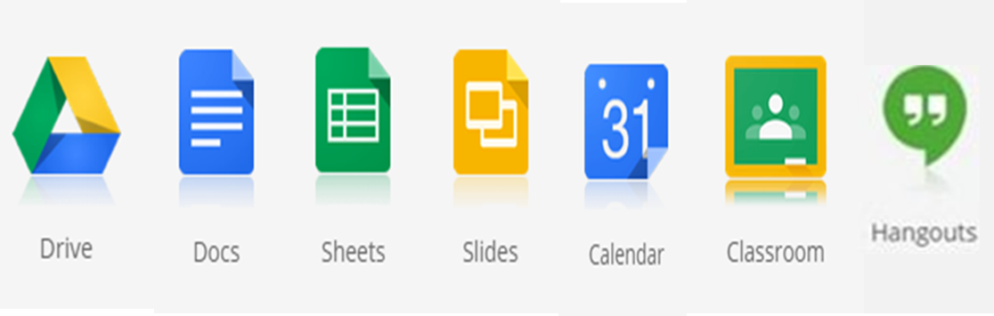


C2k Opt–in Service
Forms
Drawings

Slide 2
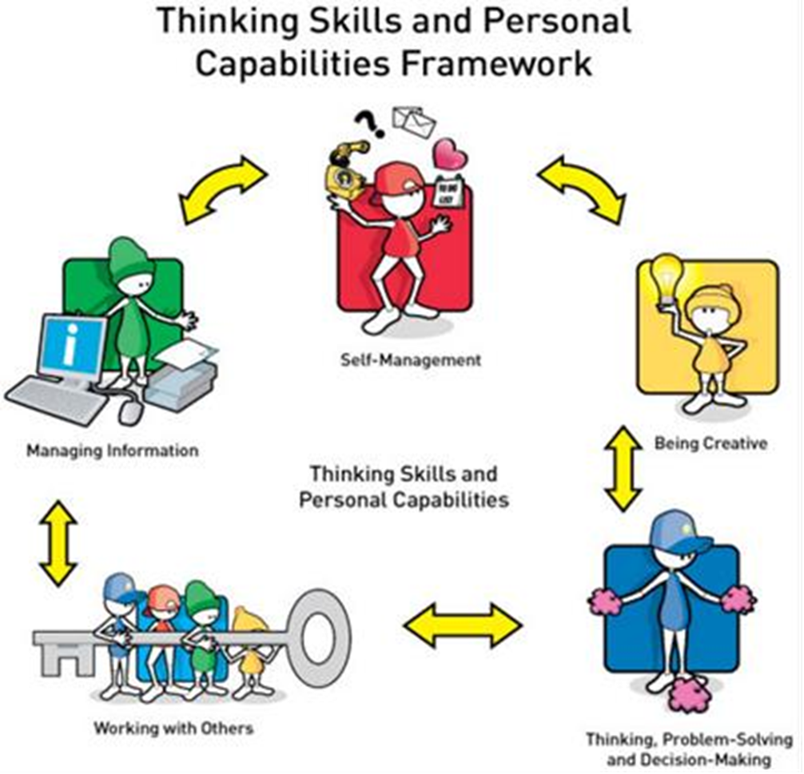

Slide 3
21st Century Tools
Real-time collaboration
Set & collect work easily
Intuitive
Syncing across Devices
Auto-saving
Unlimited storage
C2k Login

Slide 4
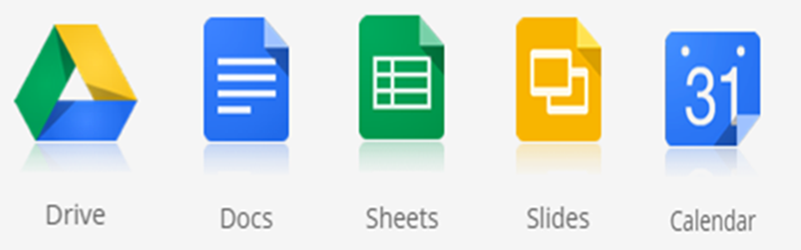
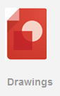


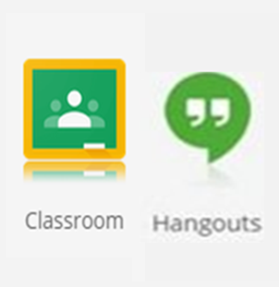
GAfE Tools
Productivity & Collaboration
Diagramming
Surveys & Quizzes
Storage & sharing
1-2-1 or Group
Voice/Video
Chats
Learning platform

Slide 5


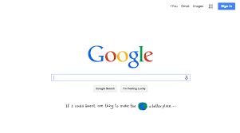


GAfE Access
Forms
Drawings
C2k Username
jbloggs123@c2ken.net

Slide 6







Sequence content and learning activities
Post announcements and questions
Slides
Drive
Sheets
Docs
Forms
Automatic creation of Drive folders for each student/assignment
Assign tasks, assess and give feedback
Calendar

Slide 7
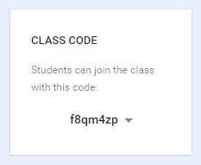
A one-off task to join the ‘Class’

Slide 8
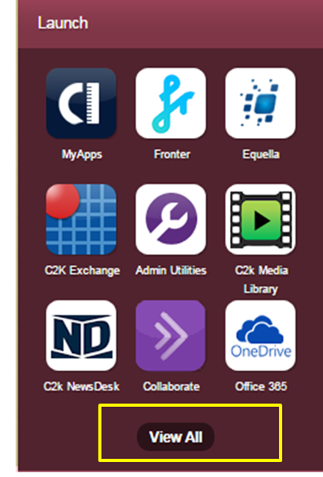
Accessing GAfE from My-School after opt-in and onboarding

Slide 9
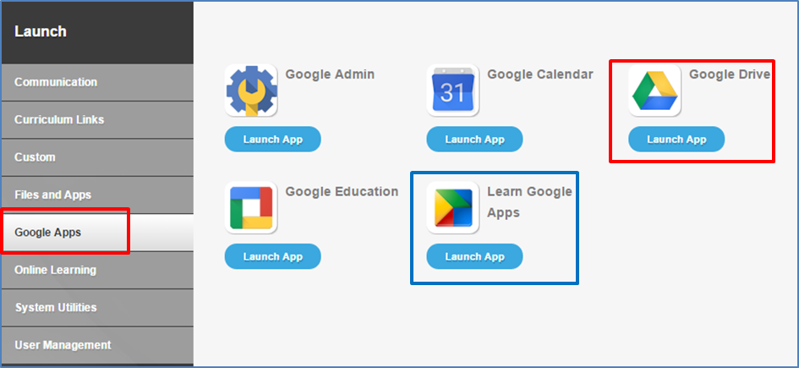

Slide 10
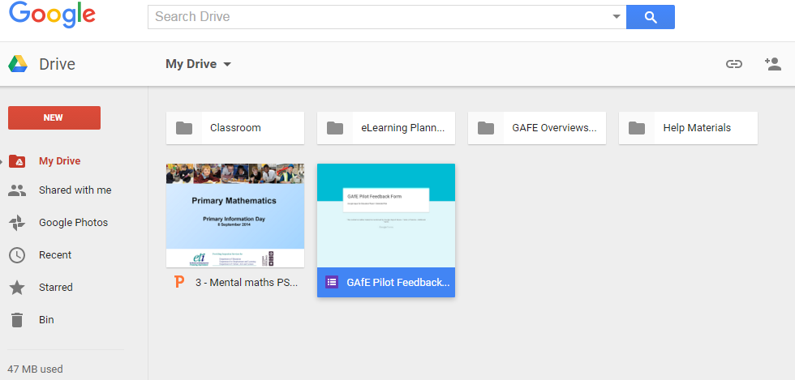

Slide 11
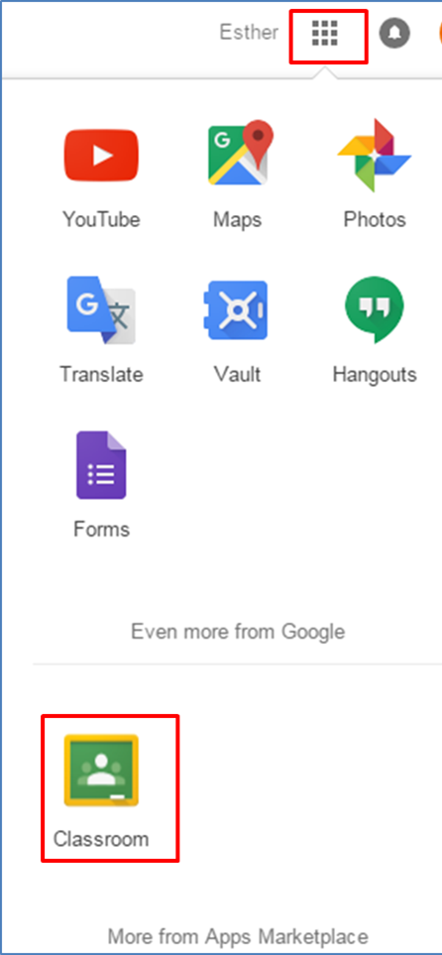

Slide 12


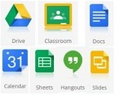








Productivity & collaboration
Regional VLE
Productivity & collaboration
Video, audio & image sharing
Literacy & more
Video Conferencing
Curriculum Resource Library
C2k Media Library
C2k NewsDesk
Relevance
Integration
Flexibility

Slide 13
Getting Access to GAfE
Opt-in form C2k Exchange |School Services |Information Management | C2k Google Apps for Education
Principal Approval
Capita Onboarding
GAfE Available & Invitation to Overview
(2hr am or pm)

Slide 14
Thank you
esther.woodhouse@c2kni.org.uk
Tel: 38 344555

